Slide 1
Film Industry Profitability Analysis
Presented: June 3, 2024
By: Tasha Peeples, Sara Simons, Deiva Ganabathy, Jonathan Yang, and Samuel DeWitt

Slide 2
Overview
Our dataset was obtained from Kaggle where we found a .csv file detailing films released from 1980 through 2020. Our goal was to explore movies across the decades and try to identify any trends in terms of what makes a movie “successful”. Our definition of success in this context comes down to the ratio between a film’s budget and its gross value; that being any film with a gross:budget ratio equal to or greater than 3:1 is considered a success for the purposes of this project.
Throughout our work we utilized Pandas, Tableau, PySpark, Spark SQL, and Google Colab to perform our analysis.

Slide 3
Project objective:
Attempt to build a model to predict future film success based off our dataset.

Slide 4
ETL Performed
Our data arrived in one .csv file, making importation simple. We transformed the data by adding a column for each row’s gross:budget ratio, off of which we created a boolean column titled “Success” which read the ratio figures and filled in a pass or fail for each film.
Other ETL work includes reformatting the release date column so we could just pull the year of release for each movie, creating columns which display the average IMDB user ratings (1-10) for the director, main writer, and main star in each film, and dropping rows for films which did not reach the 1000 user rating threshold.

Slide 5
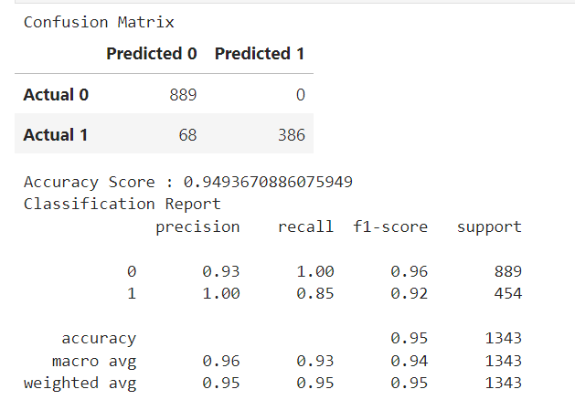
Algorithms Utilized
Random Forest
Based on the confusion matrix the high number of True Positives and True Negatives indicates that the model is performing well in identifying both successful and unsuccessful movies accurately.
The model demonstrates strong predictive capabilities, but further optimization may be necessary to improve recall for successful movies and achieve even higher accuracy.

Slide 6
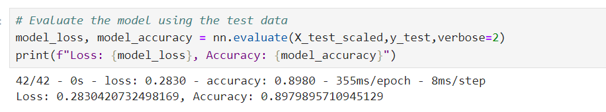
Algorithms Utilized
Neural Network
The accuracy score of 0.8980 implies that the model correctly classified around 89.80% of the movies in the test dataset. It indicates that the model is quite effective in distinguishing between successful and unsuccessful movies based on their features. The loss value of approximately 0.2830 reflects the average discrepancy between the model's predicted outcomes and the actual outcomes in the test dataset.

Slide 7
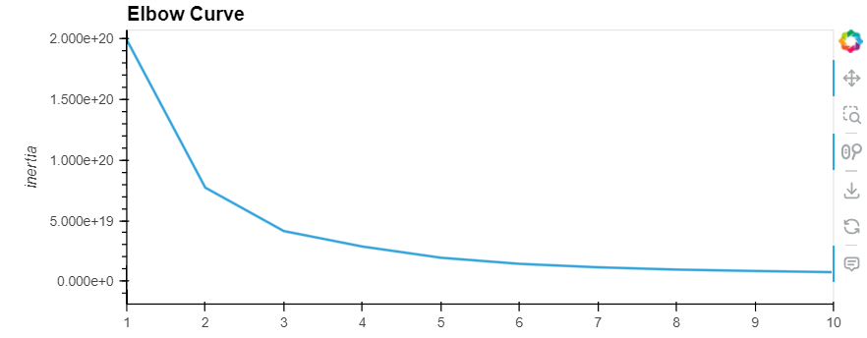
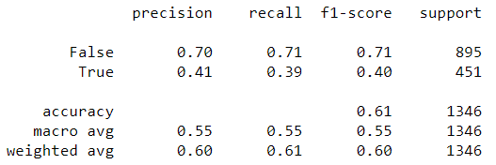
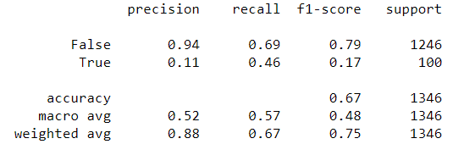
Algorithms Utilized
K Nearest Neighbors
Upon review, the KNN model did not work particularly well for our dataset. While increasing the K value during testing brings the True Negative prediction score to near perfection, the True Positive outcome is almost always missed.
Essentially, the more nearest neighbors (K-value) we added, the more this model was predicting that every film would be unsuccessful.
K = 3
K = 4

Slide 8
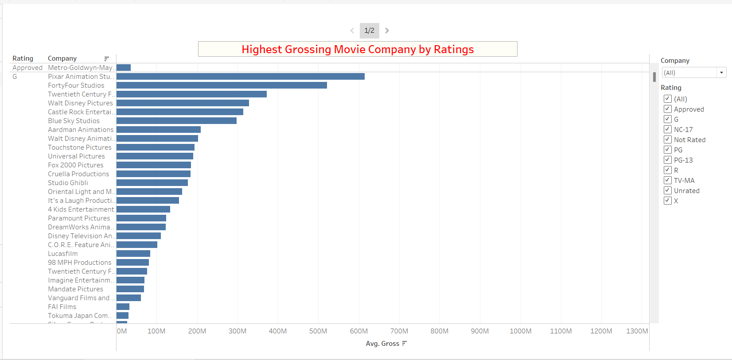
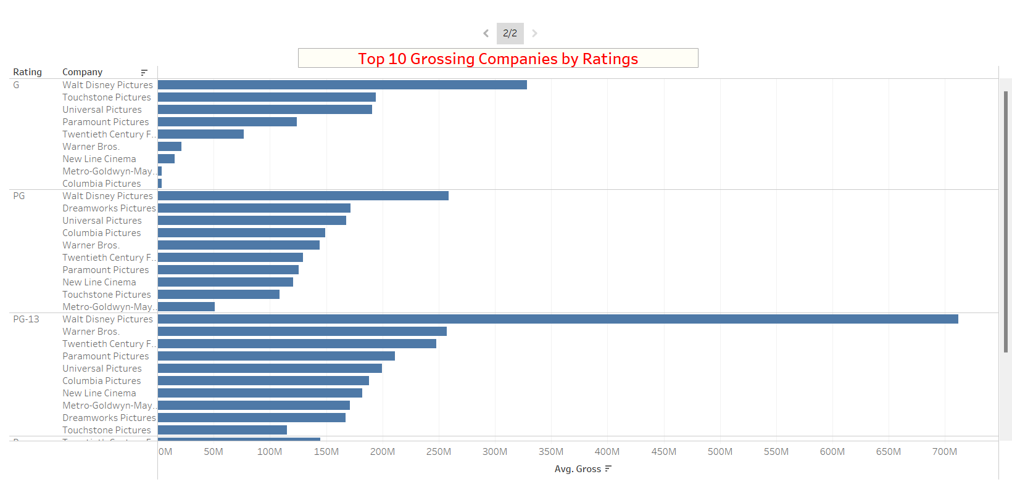
Trend Analysis and Visualization
35
22
15

Slide 9
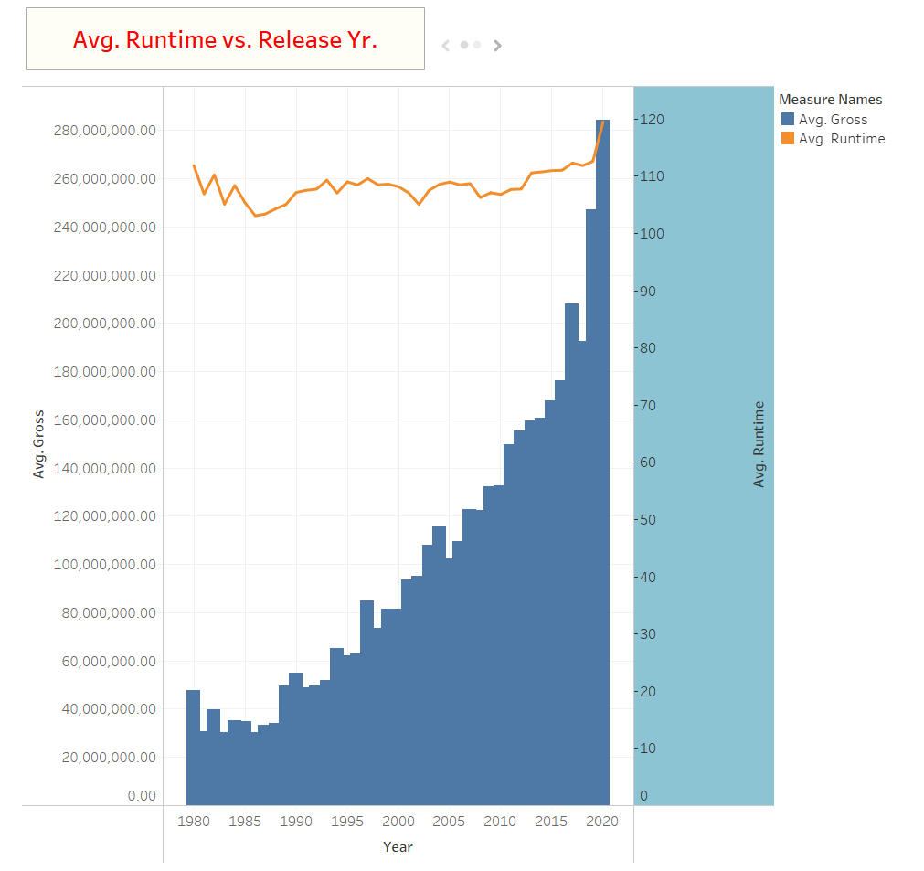
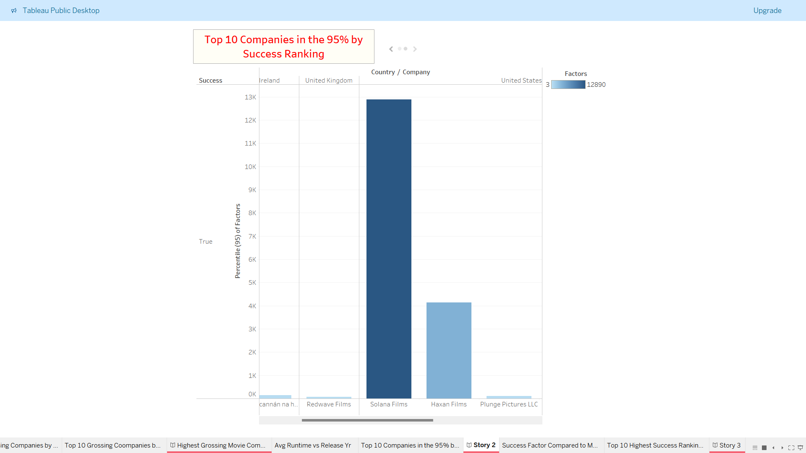
Trend Analysis and Visualization

Slide 10
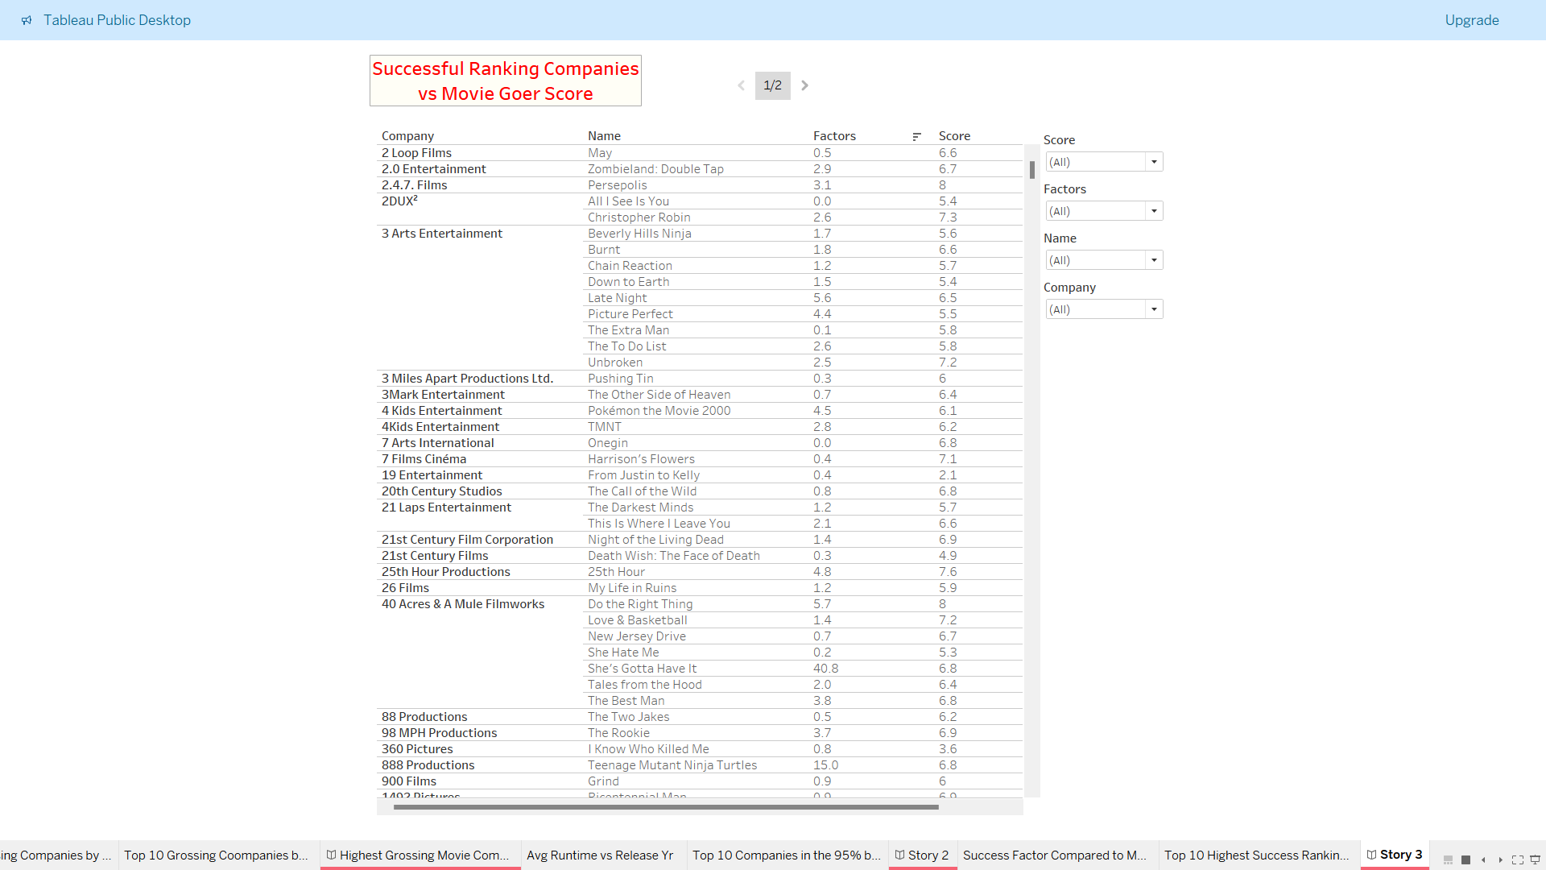
Trend Analysis and Visualization
Compared the successful ranking to the movie goers scoring.
The comparison was a stark observation as the data shows there isn’t a direct correlation between the two.

Slide 11
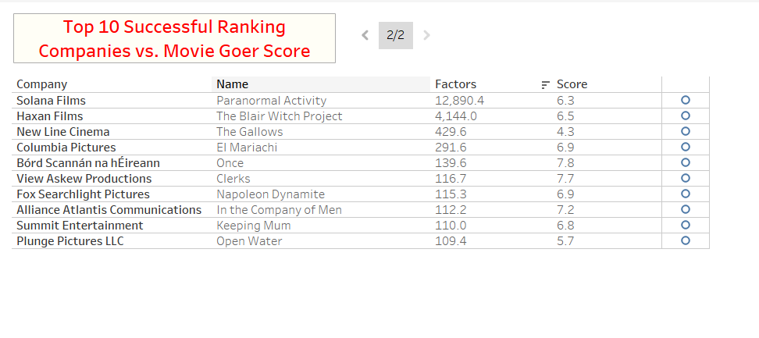
Trend Analysis and Visualization

Slide 12
Trend Analysis and Visualization
The United States has the greatest financial influence on successful movies, and of those, the most popular genre being Action movies. This play a great role in the success and popularity of these types of movies.
Disney topped the average gross figures by a wide margin, especially in the PG-13 film bracket. We theorize that this is due to Disney having a rather limited history of producing films rated in the PG-13 bracket, but the Pirates of the Caribbean series strongly buffs their earnings there.

Slide 13
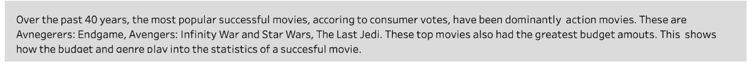
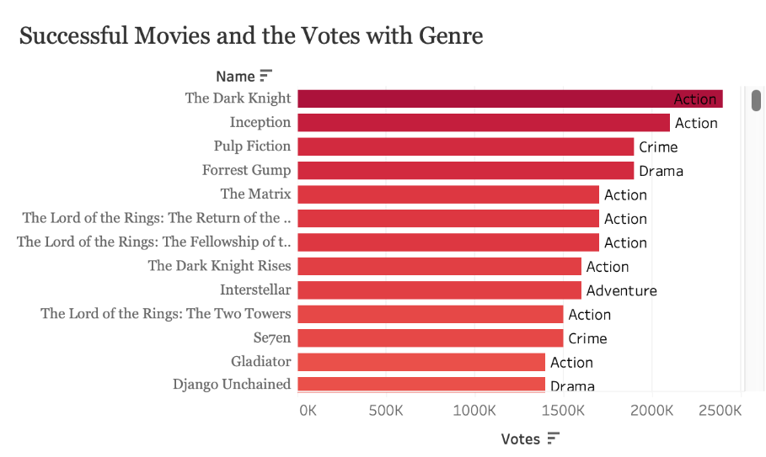
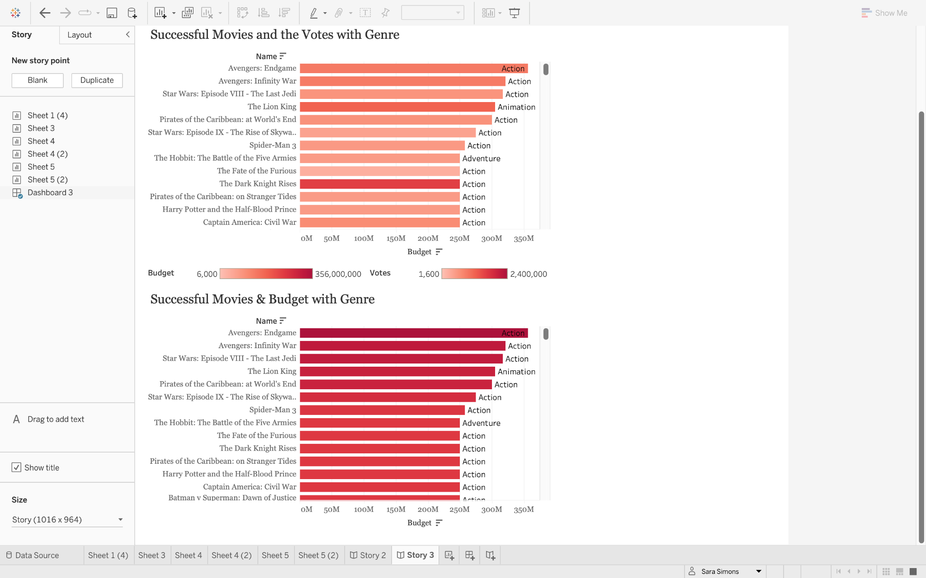
Trend Analysis and Visualization
Over past 40 years, the most popular successful movies, according to consumer votes, have been dominantly action movies. These movies include The Dark Knight and Inception, and many other top movies being action movies. We found this genre to also be the greatest budget movies (356M). This data goes to show how the budget and genre plays in to the statistics of a successful movie.

Slide 14
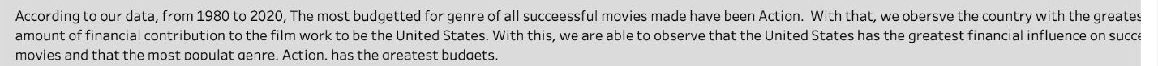
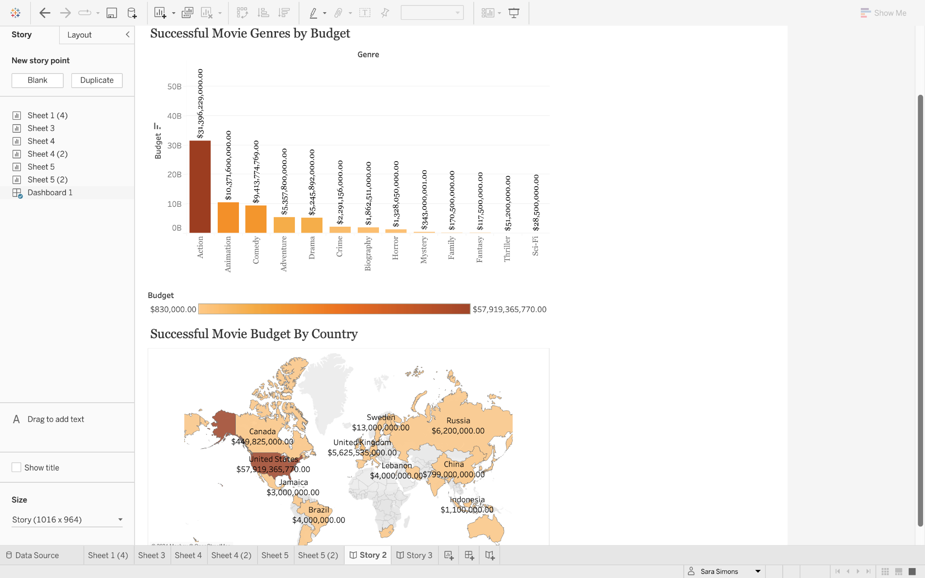
Trend Analysis and Visualization
According to our data from 1980 to 2020, the most budgeted for genre for all successful movies made have been action. With that, we also observe the country with the greatest amount of financial contribution to be the United States. We are able to conclude, the United States has the greatest financial influence on successful movies, the most popular genre, and that genre’s budget.

Slide 15
Limitations
The Dataset. Although a lot of data. Lot of it needed no be clean:
For instance many null values/lack of numerical values, duplicates, and etc.
Data Set only went to 2020.
Revenue Source. Data only included revenue earned through the theaters/box office.

Slide 16











The Team (and our Favorite Films!)
Sara Simons
Deiva Ganabathy
Tasha Peeples
Jonathan Yang
Sam DeWitt
Girl’s Trip
Turning Red
The Blind Side
The Pursuit of Happyness
Titanic
Dangal
The Ugly Truth
PS I Love You
It’s Complicated
Crazy Rich Asians
About Time
T-Swift Eras Tour!
Airplane!
In Bruges
Jarhead

